Slide 1
Beyond Words
Examining Implicit Social Expectations in Job Descriptions for Computer Science Positions
Ayomide I. Johnson
Towson University
Diversity, Equity, and Inclusivity Office

Slide 2

Introduction
Ayomide Johnson, (he/him)
Born in Nigeria
College: Towson University
Major: Computer Science, BS
DEIO
Interested in technology since a young age
When it’s all said and done, as a programmer, I want to have a voice to help people and give others a path to success.
Notes:
However, I have lived in the United States for majority of my life.
I’ve always been interested in technology since I was young and still remember my first robotics competition in elementary school.

Slide 3

project Introduction
Research Question: Are there word patterns or phrases commonly used in job descriptions for computer science positions, and do these language patterns indicate that there may be bias in the recruitment process?
The importance of this research question, is to show crucialness to collaborate, discuss findings, and implement changes to create a more inclusive and unbiased environment for hiring in computer science positions.

Slide 4
why is it relevant
Barrier analysis
Foster innovation^{1,2}
Improve problem-solving^{1,2}
Ensure ethical considerations
Create inclusive technology³
Diversity
Organization benefits
Harvard Business Review, “How Diversity Can Drive Innovation”
Boston Consulting Group, “The Mix That Matters: Innovation through Diversity”
LinkedIn: “Development of Inclusive Technology”
Notes:
Addressing implicit biases and promoting diversity in computer science is essential for fostering innovation, improving problem-solving, ensuring ethical considerations, creating inclusive technology, and staying relevant in an increasingly diverse world.

Slide 5
why is it relevant
Organization benefits
Challenges discriminatory practices^{1,2}
Reduces impact to marginalized groups^{1,2}
Promotes equal opportunities^{1,2,3,4}
Barrier analysis
Diversity
Yi Chern Tan, L. Elisa Celis. “Assessing Social and Intersectional Biases in Contextualized Word Representations”
Charity So White, “Language Barriers: How Our Words Obscure Bias and Discrimination”
Deloitte, “Core Beliefs and Culture”
McKinsey, “Diversity Wins How Inclusion Matters”
Notes:
Identifying social expectations embedded in job descriptions helps reduce barriers that may disproportionately affect marginalized groups. It promotes equal opportunities and challenges discriminatory practices in the hiring process.

Slide 6
why is it relevant
Diversity
Diversity
Increase creativity^{1,2}
Improve problem-solving^{1,2}
Better understand diverse user needs³
Attract broader range of talent⁴
Organization benefits
Barrier analysis
Harvard Business Review, “How Diversity Can Drive Innovation”
Boston Consulting Group, “The Mix That Matters: Innovation through Diversity”
LinkedIn: “Development of Inclusive Technology”
Forbes: “How Diversity and Innovation Drive Great Cultures in the Future of Work”
Notes:
Creating diverse and inclusive teams has numerous benefits, such as increased creativity, improved problem-solving, and better understanding of diverse user needs. By addressing biases in job descriptions, organizations can attract a broader range of talent and enhance their overall performance.

Slide 7
Why start with computer science
Source: Computer science 1550 series by Opm fed scopes, Federal work force by Opm fed scopes
Notes:
Representation helps dreamers feel that their goals are achievable and can bring comfort by helping filling the void of loneliness because others know your pain.

Slide 8
Why start with computer science
Source: Computer science 1550 series by Opm fed scopes, Federal work force by Opm fed scopes, and CLF by BLS Reports: U.S. Bureau of Labor Statistics
Notes:
Representation helps dreamers feel that their goals are achievable and can bring comfort by helping filling the void of loneliness because others know your pain.

Slide 9
Source: Computer science 1550 series by Opm fed scopes, Federal work force by Opm fed scopes
Notes:
The representation gap between representation in the 1550 series and overall federal employees by pay scale is plotted here.
Positive values indicate overrepresentation, and negative values indicate underrepresentation. You can see that white employees are overrepresented in every category except the center of the distribution ($120,000 - $129,000). Additionally, white employees are extremely overrepresented in the 1550 series at the highest pay scales. Asians are also overrepresented in every category except the uppermost pay category, but they are most dramatically overrepresented in the 1550 series in the middle pay scales. By contrast, you can also see that black/African Americans, Hispanic/Latino, and American Indian or Alaska Natives are underrepresented across the entire spectrum.

Slide 10
Where could bias Be?
Description of qualifications, competencies, and duties
GS scale requirements and pay scale
Embedded in the job analysis used to create the vacancy.
Certain time periods (e.g., between OPM guideline updates, DEIA strategic plans, etc. These interventions might show a reduction in bias indicators.)
Research Question: Are there word patterns or phrases commonly used in job descriptions for computer science positions, and do these language patterns indicate that there may be bias in the recruitment process?
Notes:
*We are exploring this research project from the lens of a hiring manager (and or Subject Matter Expert) to see if there is a preconceived notion of what a computer scientist should look like or be like. This affects the descriptions and competencies selected to fulfill the job analysis used to create the vacancies. The language of the job analysis is used to write the duties or major duties of a job opportunity announcement, which is why the duties and major duties section of the job announcements was selected for analysis.

Slide 11
PROJECT WORKFLOW
Coding Language Selection
API
Experimental Parameters
Text Mining Code
Data Set of Computer Science 1550 Series
Curated Data Set
Data Analysis
Discussion
Full Scope of Project
Notes:
Data set of Computer Science 1550 series: is the overview of all computer science series (Control group)
Curated Data Set: is the GS comparison (experimental group)
The variables are the GS

Slide 12

Coding language selection
Machine Learning
Academic Scientific Research
Advance Analytics
Data Science
Predictive analytics
Statistics
Notes:
Visual description: image of blue and yellow pythons and text bubbles
Originally the only language I knew was java
While java is a great coding language for many things like organization and runtime
Python Is a great option for this project because of its data analysis functions, such as analyzing, manipulating, cleaning, and visualizing data.

Slide 13
PROJECT WORKFLOW
Coding Language Selection
API
Experimental Parameters
Text Mining Code
Data Set of Computer Science 1550 Series
Curated Data Set
Data Analysis
Discussion
Full Scope of Project
Notes:
Data set of Computer Science 1550 series: is the overview of all computer science series (Control group)
Curated Data Set: is the GS comparison (experimental group)
The variables are the GS

Slide 14
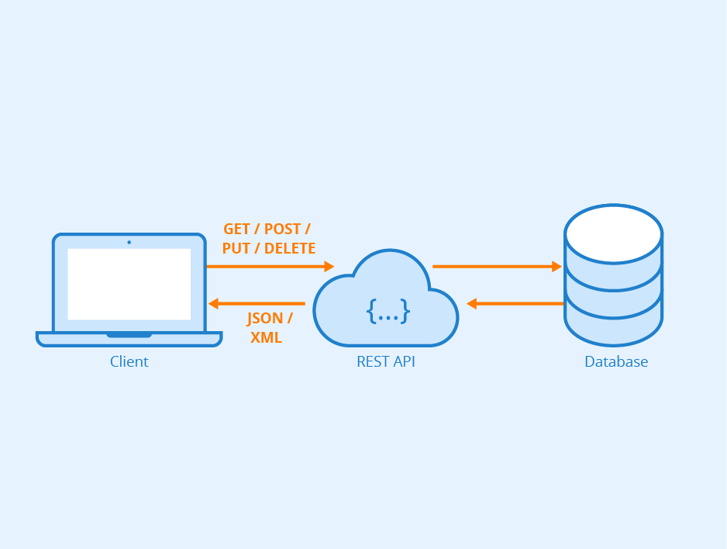
What is an API
Application Programming Interface: is a set of rules that enables software applications to communicate and interact with each other.
Source: https://blog.iron.io/what-is-rest-api/
Notes:
It acts as a bridge, allowing applications to access functionalities and data from other systems. APIs simplify integration, foster interoperability, and empower developers to create connected applications.

Slide 15

How I used the USA jobs Api
Familiarize Usajobs.gov API documentation and choosing parameters
API request
Parse API response
Notes:
Documentation: endpoints, format, and parameters
Request: what I am asking
Parse: examine the data giving back
Through these steps I was able to use the usajobs Api which allowed me to go into past jobs posting on usajobs.gov and gave me access to see the job description, qualification and the responsibilities/duties of the job

Slide 16
PROJECT WORKFLOW
Coding Language Selection
API
Experimental Parameters
Text Mining Code
Data Set of Computer Science 1550 Series
Curated Data Set
Data Analysis
Discussion
Full Scope of Project
Notes:
Data set of Computer Science 1550 series: is the overview of all computer science series (Control group)
Curated Data Set: is the GS comparison (experimental group)
The variables are the GS

Slide 17
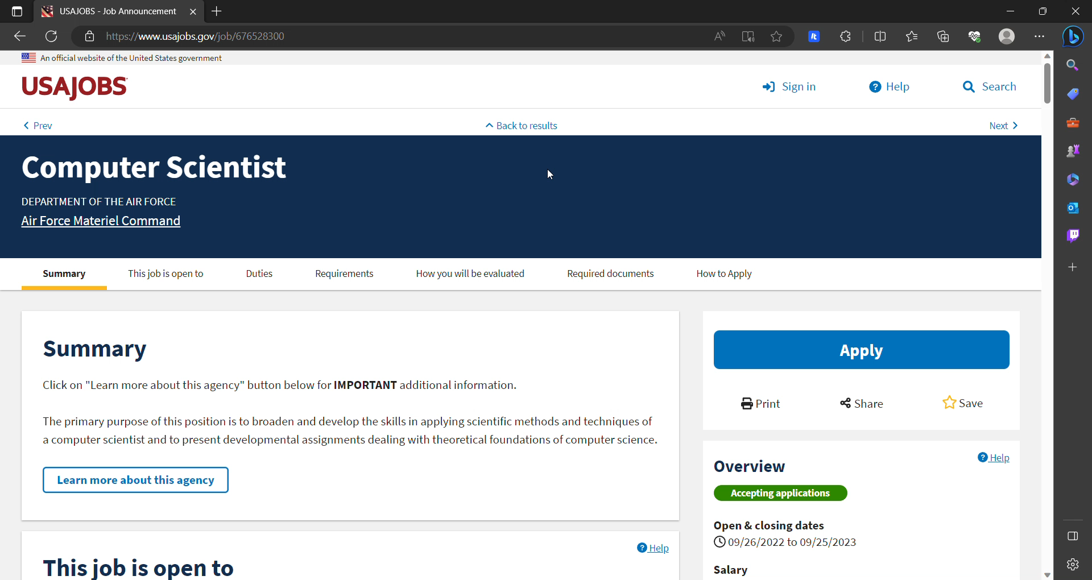
Experimental parameters
Endpoints:
Historic job ads
Parameters:
Position Series (1550: Computer Science)
Time period (2021)
Sample size (random pool of 1000 historic job ads)
Notes:
This endpoint is used to retrieve historical job opportunity announcements (JOAs) data.
I want to target a specific position series, and this helps me accomplish this.
This help me target a certain year. Like we talked about before there may be bias stronger in certain years
This was for practicality, and includes a sample of 1000 job of the series 1550

Slide 18
PROJECT WORKFLOW
Coding Language Selection
API
Experimental Parameters
Text Mining Code
Data Set of Computer Science 1550 Series
Curated Data Set
Data Analysis
Discussion
Full Scope of Project
Notes:
Data set of Computer Science 1550 series: is the overview of all computer science series (Control group)
Curated Data Set: is the GS comparison (experimental group)
The variables are the GS

Slide 19
Text mining Code
A code that takes in a file and counts the occurrences of every word
Creating a list of symbols that will be removed when seen
Use a language tool kit
Create a word cloud that will help visualize our data
Notes:
What I choices to made for the importance of data
text mining: this is where you can talk about: your data handling, your engineering design, engineering documentation –
all of this you can wrap around factors like your choice on stop wards, limitatizations/stemming etc

Slide 20
PROJECT WORKFLOW
Coding Language Selection
API
Experimental Parameters
Text Mining Code
Data Set of Computer Science 1550 Series
Curated Data Set
Data Analysis
Discussion
Full Scope of Project
Notes:
Data set of Computer Science 1550 series: is the overview of all computer science series (Control group)
Curated Data Set: is the GS comparison (experimental group)
The variables are the GS

Slide 21
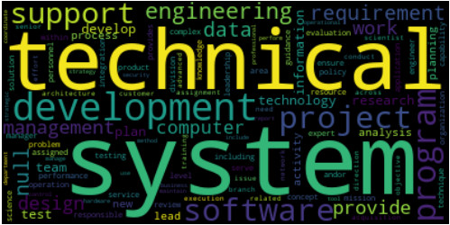
Data set of Computer Science 1550 series
Most occurred words:
System 36.6%
Technical 28.7%
Development 23.1%
Program 16.9%
Project 15.7%
Software 15.3%
Support 14.8%
Engineering 14.7%
Requirement 12.3%
Data 12.2%

Slide 22
PROJECT WORKFLOW
Coding Language Selection
API
Experimental Parameters
Text Mining Code
Data Set of Computer Science 1550 Series
Curated Data Set
Data Analysis
Discussion
Full Scope of Project
Notes:
Data set of Computer Science 1550 series: is the overview of all computer science series (Control group)
Curated Data Set: is the GS comparison (experimental group)
The variables are the GS

Slide 23
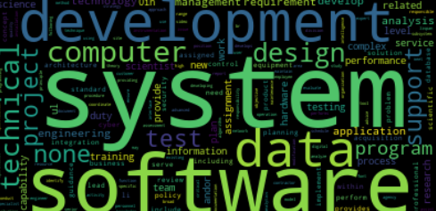
Curated Data Set
Word Cloud for GS Scale of 12 and lower
Most occurred words:
System 16.6%
Software 9.5%
Development 9.2%
Data 9.1%
Computer 8.2%
Technical 7.1%
Design 6.8%
Support 4.8%
Project 4.7%
test 4.7%

Slide 24
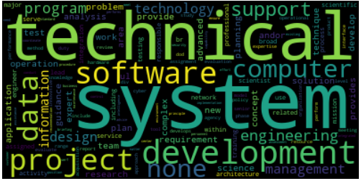
Continued
Word Cloud for GS 13 and 14
Most occurred words:
System 18.0%
Technical 12.7%
Development 11.3%
Software 9.6%
Project 9.3%
Data 8.6%
Computer 7.1%
Support 6.7%
Engineering 6.7%
Program 6.1%

Slide 25
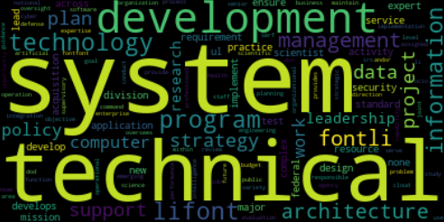
Continued
Word Cloud for GS 15
Most occurred words:
System 6.7%
Technical 5.9%
Development 5.7%
Technology 4.2%
Program 4.1%
Information 3.7%
Management 3.2%
Architecture 3.0%
Support 2.8%
Project 2.7%

Slide 26
PROJECT WORKFLOW
Coding Language Selection
API
Experimental Parameters
Text Mining Code
Data Set of Computer Science 1550 Series
Curated Data Set
Data Analysis
Discussion
Full Scope of Project
Notes:
Data set of Computer Science 1550 series: is the overview of all computer science series (Control group)
Curated Data Set: is the GS comparison (experimental group)
The variables are the GS

Slide 27
Data analysis
GS Scale 12 and lower
GS Scale 13 and 14
GS Scale 15
Most occurred words:
System 16.6%
Software 9.5%
Development 9.2%
Data 9.1%
Computer 8.2%
Technical 7.1%
Design 6.8%
Support 4.8%
Project 4.7%
test 4.7%
Most occurred words:
System 18.0%
Technical 12.7%
Development 11.3%
Software 9.6%
Project 9.3%
Data 8.6%
Computer 7.1%
Support 6.7%
Engineering 6.7%
Program 6.1%
Most occurred words:
System 6.7%
Technical 5.9%
Development 5.7%
Technology 4.2%
Program 4.1%
Information 3.7%
Management 3.2%
Architecture 3.0%
Support 2.8%
Project 2.7%
Notes:
What have we concluded from the curated data also original data set(control vs experimental)?

Slide 28
PROJECT WORKFLOW
Coding Language Selection
API
Experimental Parameters
Text Mining Code
Data Set of Computer Science 1550 Series
Curated Data Set
Data Analysis
Discussion
Full Scope of Project
Notes:
Data set of Computer Science 1550 series: is the overview of all computer science series (Control group)
Curated Data Set: is the GS comparison (experimental group)
The variables are the GS

Slide 29


Discussion
What data truly means?
What impact does it show or have?
What questions does this raise?
Notes:
Keep in mind: interesting context of words used in lower GS scales

Slide 30
PROJECT WORKFLOW
Coding Language Selection
API
Experimental Parameters
Text Mining Code
Data Set of Computer Science 1550 Series
Curated Data Set
Data Analysis
Discussion
Full Scope of Project
Notes:
Data set of Computer Science 1550 series: is the overview of all computer science series (Control group)
Curated Data Set: is the GS comparison (experimental group)
The variables are the GS

Slide 31
Expanding the project: possibilities
Word associations: context such as bigrams and engrams, or socio-linguistic associations
Making my own stop words directly for project
Time series (e.g., between OPM guideline updates, DEIA strategic plans, etc.)
Larger sample size (reduces uncertainty and deviation)
Visualize data

Slide 32

Next StepS
Agencies and HR data
Demographics
Promotion
Retention data
Notes:
Barrier analysis

Slide 33
Lessons learned
Technical lessons
Programming language changes how you tackle a problem
To learn exactly what all your libraries contain and do.
How to make visualizations and represent data.
Data gathering and handling.
Life lessons
Work environment
Networking
Notes:
API documentation is not unified
Learned what type of team I want to work with and for
People are more willing to help than you think
Network

Slide 34
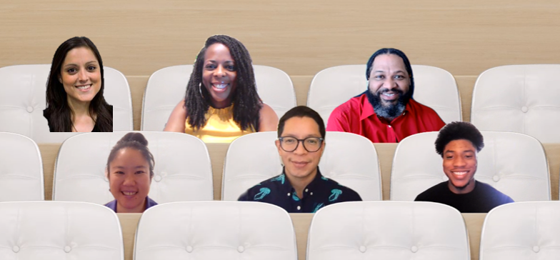
Acknowledgements
DEIO team
Jo Wu (SURF mentor)
Juan Fung (SURF mentor)
Jeanita Pritchett
Sherwin McAdam
Carina Hahn
Additional help
Craig Greenberg
Rachael Sexton
Asia Robertson
Family and friends
Professor Johannes Adebanjo

Slide 35

Get in touch with me
Personal Email: ayojohnson29@gmail.com
GitHub: AyomideJohnson
Questions to leave you with:
What has been the most helpful or surprising information I shared with you today?
How would you implement these ideas for reducing implicit bias or increasing diversity in your workplace?
I invite your collaboration to advance the goals of DEIA and the project possibilities I spoke on.

